Slide 1

SHRI SANT GAJANAN MAHARAJ COLLEGE OF ENGINEERING SHEGAON Department Of Electronics and Telecommunication Engineering
GROUP MEMBERS:- Name of GUIDE:-
Anamika Rewale Dr. Rupesh Mahamune
Kirti Raut
Abhishek Atole
Abhishek Raut

Slide 2
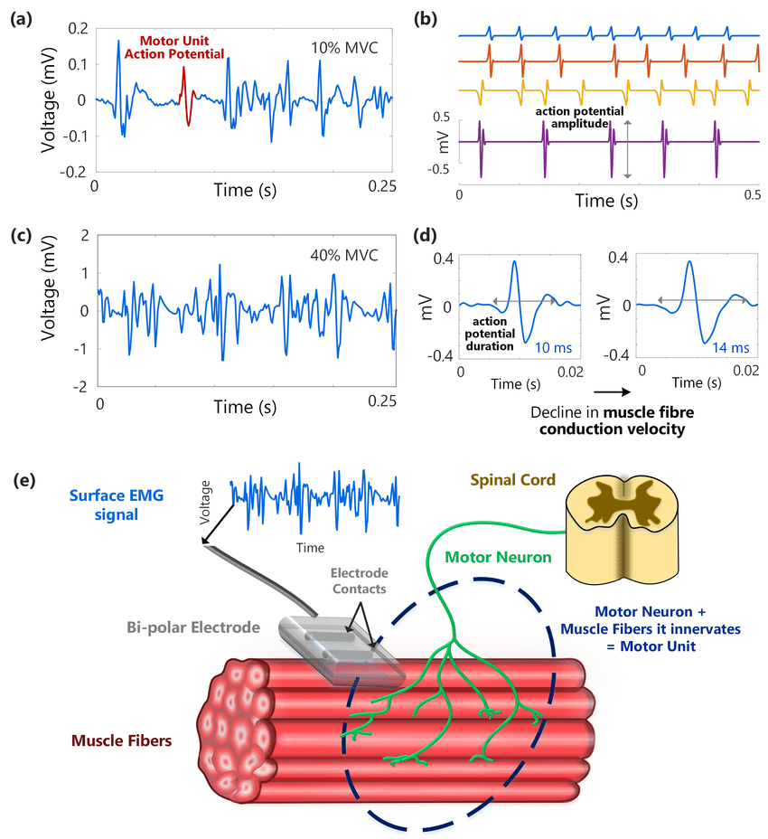
Classification of EMG Signals Using Convolutional Neural Networks
A Powerful Approach for Understanding Muscle Activity

Slide 3
Index
Introduction
Literature survey
Objectives
Database Details
Architecture of CNN
Block Diagram
Performance Evaluation
Results and Analysis
Conclusion
Bibliography

Slide 4
LITERATURE SURVEY
Sr.no | Authors | Title paper | Method Analysis
1 | Nikolaos Tsagkas Tanagiotis Tsinganas | On the Used of Deeper Cnns in Hand Gesture Recognition based on sEMG signals | Utilizes Sliding Window Method for signal processing. Signals low pass filtered at 1Hz. Applies sliding window of 150ms length with 60% overlap for CNN input image construction. Constructs images with a resolution of 10 x 15. [1]
2 | Manfredo Atzori Matteo Cognolato | Deep Learning with Convolutional Neural Networks Applied to Electromyography Data: A Resource for the Classification of Movements for Prosthetic Hands | Utilizes CNNs for enhancing artificial hands' understanding of muscle signals. Aims to improve precision in movement for prosthetic hands. Project employs advanced technology to enhance functionality of prosthetic hands. [2]

Slide 5
Sr.no | Authors | Title paper | Method Analysis
3 | Kaan Bakırcıoğlu Nalan Özkurt | Classification of Emg Signals Using Convolution Neural Network | Uses CNN for efficient EMG signal classification of daily hand movements. Avoids manual feature extraction, employing raw signals, Fourier transforms, root mean square, and EMD. Achieves high accuracy (95.90%) with EMD-processed signals, showcasing deep learning's effectiveness. [4]
4 | Sami Briouza Hassène Gritli Nahla Khraief Safya Belghith Dilbag Singh | A Convolutional Neural Network-Based Architecture for EMG Signal Classification | Proposes a featureless CNN for automatic EMG signal classification in wrist and finger motions. Shows effectiveness without pre-selected features, with applications in prostheses and rehabilitation. Evaluated on Ninapro Database 2 with 40 subjects and 49 motions. [5]
5 | Lobov S. Krilova N. Kastalskiy I. Kazantsev V. Makarov V.A. | Latent Factors Limiting the Performance of sEMG-Interfaces. Sensors | EMG Pattern Database contains raw EMG data recorded from MYO Thalamic bracelet on forearms of 36 subjects. Eight evenly spaced sensors on the forearm transmit myographic signals via Bluetooth to a PC. Dataset captures myographic signals during static hand gestures. [3] .

Slide 6
Objectives
To design feature extraction technique
To develop a novel CNN model for classification of sEMG signal
To Increase the Accuracy of the Model

Slide 7
Database Details
Overview:
Dataset of electromyographic (EMG) patterns from 36 subjects using MYO Thalmic bracelet [3] .
Captures static hand gestures (fist, wrist flexion/extension, radial/ulnar deviation, palm extension).
Each gesture held for 3 seconds, with 3-second pause between gestures.
Content:
11 columns per dataset file. Contains total 1048576 Signals data.
Recorded using MYO Thalamic bracelet, a PC, and Bluetooth receiver.
Bracelet equipped with eight sensors capturing myographic signals.
Data Acquisition:
MYO Thalmic bracelet with 8 EMG sensors spaced around forearm.
Signals transmitted via Bluetooth to PC.

Slide 8
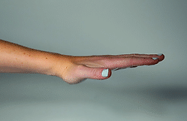
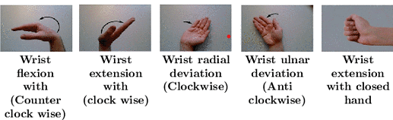
Dataset File Structure
Data is organized in columns:
Time (ms): ( 1 ) Records the timestamp of each data point in milliseconds.
Channels 1-8 : (2- 9) Eight columns representing the raw EMG signals from each sensor on the MYO Thalmic bracelet.
Class: ( 10 ) Indicates the gesture performed with the following categories:
0: Unmarked data (excluded from analysis)
1: Hand at rest
2: Hand clenched in a fist
3: Wrist flexion
4: Wrist extension
5: Radial deviation
6: Ulnar deviation
Label: ( 11) Identifies the subject group (1-9), each containing four subjects.
(1) (2) (3) (4) (5) (6)

Slide 9
Database Details
Additional Information:
"label" column added, indicating the subject who performed the experiment.
Total of 36 subjects, each performing 7 gestures twice.
Acknowledgements:
Thanks to the UCI Machine Learning Repository and researchers for providing open data.
Relevant Paper:
Title: "Latent Factors Limiting the Performance of sEMG-Interfaces."
Authors: Lobov S., Krilova N., Kastalskiy I., Kazantsev V., Makarov V.A.
Published in Sensors in 2018.
DOI: 10.3390/s18041122

Slide 10
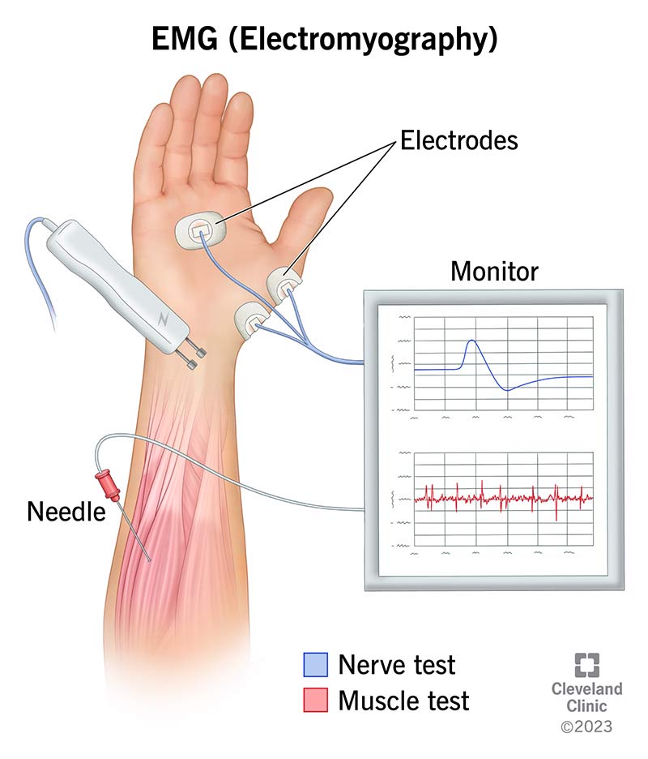
What are EMG Signals?
Breakdown of the acronym:
Electro: Refers to the electrical nature of the signals, generated by the movement of ions within muscle cells.
Myo: Derived from the Greek word "myo" meaning muscle.
Graphy: Denotes the recording and analysis of these signals.
Different types of EMG signals:
Surface EMG: Recorded using electrodes placed on the skin above the muscle, suitable for studying overall muscle activity.
Intramuscular EMG: Requires inserting needle electrodes directly into the muscle, offering more detailed information about individual muscle fibers.
Factors influencing EMG signals:
- Muscle force and contraction intensity - Muscle fatigue and exhaustion
- Nerve impulses controlling muscle - Electrode placement and recording activation conditions

Slide 11
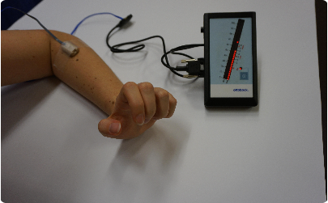
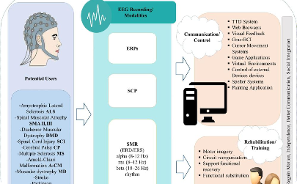

Applications of EMG signals
Prosthetics and assistive devices
Human-computer interaction and gaming
Clinical diagnosis and research
Rehabilitation and physical therapy
Sports science and performance analysis
From controlling prosthetic limbs to monitoring muscle recovery

Slide 12
Basics of Convolutional Neural Networks (CNNs)
Feature Extraction
Deep Learning Model
Image Recognition
1
2
3
CNNs perform feature extraction on input data, allowing them to identify patterns and important features within the data. This process involves the use of filters and pooling layers to capture relevant information
CNNs are a class of deep learning neural networks, specifically designed to analyze visual data. They consist of multiple layers that learn to extract features and make predictions based on input data.
CNNs are widely used for image recognition tasks, such as object detection and classification. Their ability to understand spatial hierarchies makes them valuable for processing visual information.

Slide 13
Sliding Window Technique
Definition: The sliding window technique in Convolutional Neural Networks (CNNs) involves systematically moving a small window or filter across the input data.
Convolution Operation: The window, also known as a kernel, convolves with the input data by element-wise multiplication and summation.
Feature Extraction: As the window slides, it extracts local features from different parts of the input, capturing spatial hierarchies.
Parameter Sharing: The same set of weights in the window is applied to different regions of the input, promoting parameter sharing and reducing the overall number of parameters.
Spatial Hierarchies: The sliding window allows the network to learn hierarchical representations, recognizing low-level features in early layers and complex patterns in deeper layers.
Pooling: Often combined with pooling layers to down sample the spatial dimensions, reducing computational complexity and focusing on essential features.
Strides: The step size of the sliding window, influencing the degree of overlap between neighboring regions and affecting the output spatial dimensions.

Slide 14
Fourier Transform Technique
Objective: The main aim is to classify Electromyography (EMG) signals effectively.
Methodology: The chosen approach involves applying Fourier Transform for in-depth signal analysis.
Implementation: This process entails transforming the original EMG signal into the frequency domain, yielding a detailed representation.
Result: The crucial outcome is the extraction of essential frequency components, providing pivotal information for subsequent classification.
Importance: The adoption of Fourier Transform significantly enhances our ability to understand and categorize EMG signals, offering improved signal processing and interpretation for applications like prosthetics and muscle activity studies.

Slide 15


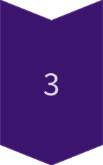
Architecture of the CNN model for EMG signal classification
Input layer
The input layer receives preprocessed EMG signal data, forming the initial stage of information processing within the CNN model.
Convolutional Layers
Convolutional layers perform feature extraction, capturing relevant spatial patterns and characteristics within the input EMG signal data
Flatten Layer:
The Flatten layer converts the multi-dimensional output to a one-dimensional vector, facilitating compatibility with fully connected layers in a Convolutional Neural Network.
Fully connected Layer
These layers extract high-level features, leading to the classification of EMG signals into distinct categories based on learned characteristics.

Slide 16
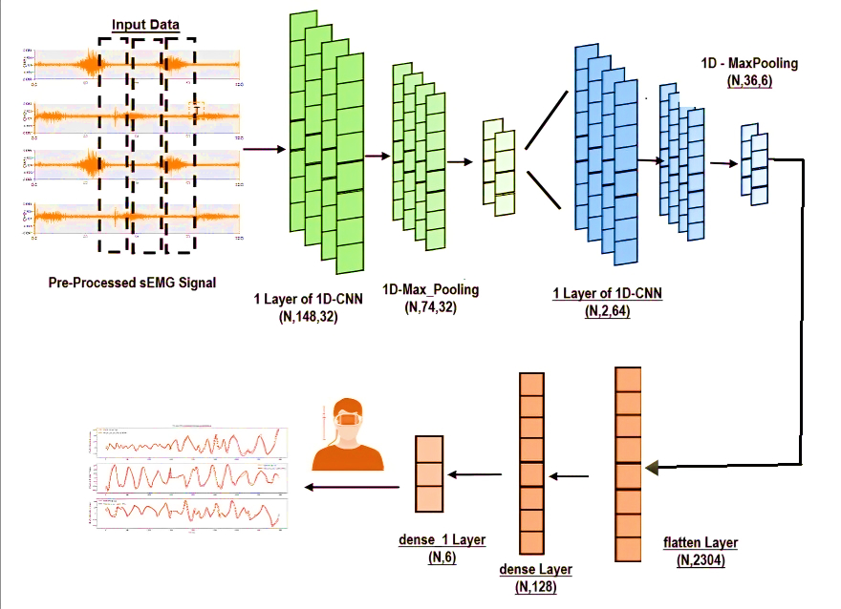
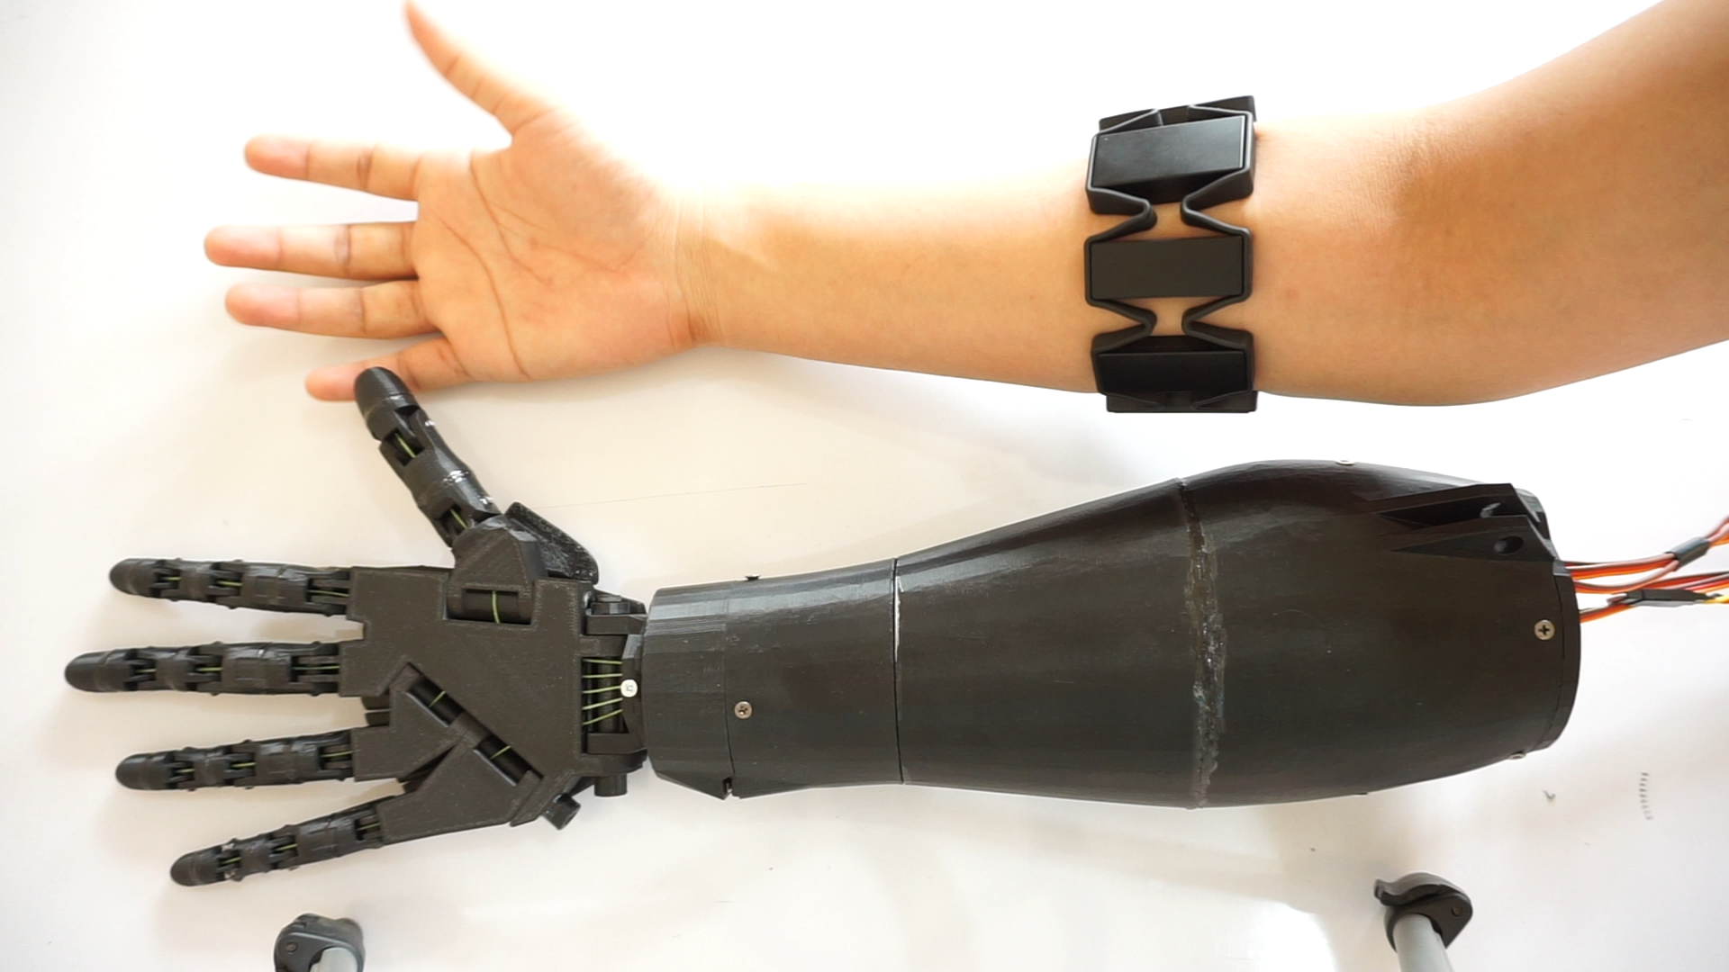
Architecture of CNN

Slide 17
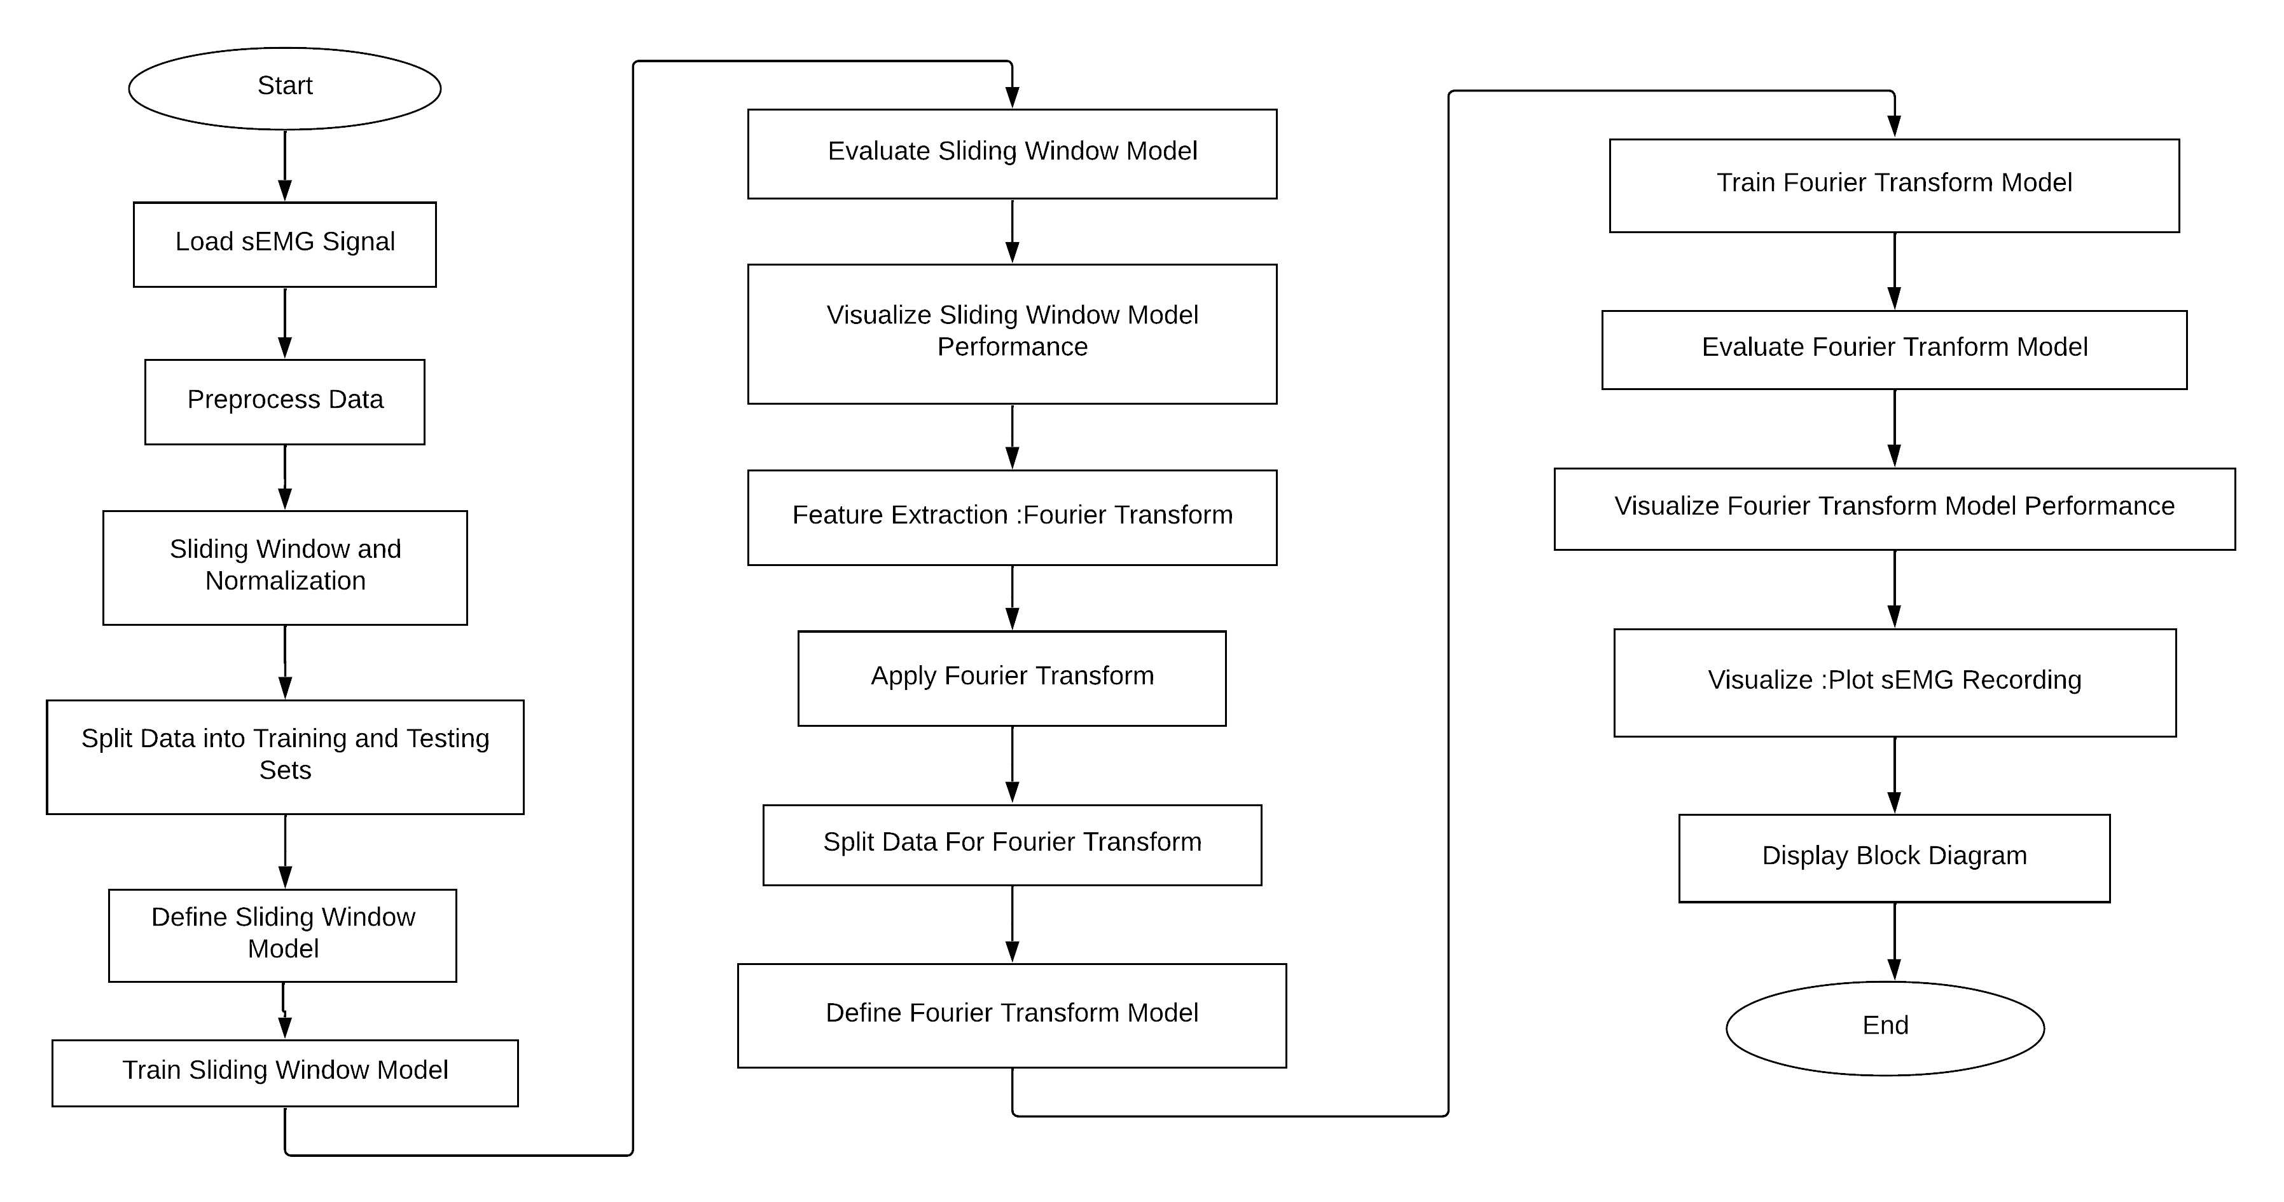
Block Diagram

Slide 18
How CNNs Work for EMG Signals
Data Loading and Preprocessing
1
2
CNN Model Definition:
3
Training and Evaluation:
Load EMG dataset from a CSV file and drop unnecessary columns.
Normalize data to scale values between 0 and 1.
Apply sliding window technique to segment time-series data.
Sequential model with convolutional layers, max-pooling layers, and dense layers.
First convolutional layer with 32 filters, kernel size of 3, and ReLU activation.
Model compiled using Adam optimizer and sparse categorical cross-entropy loss.
Split dataset into training and testing sets.
Train CNN model on the training set for a specified number of epochs.
Visualize learning curves (training and validation loss).
Evaluate model on the testing set, compute accuracy, F1 score, and generate a confusion matrix.
Display a detailed classification report.

Slide 19
How CNNs Work for EMG Signals
Feature Extraction Techniques:
4
5
Training and Evaluation of Fourier Transform and RMS Models:
6
Visualization:
Visualize learning curves for the original CNN model.
Display confusion matrices for all models.
Provide insights into training progress and model performance.
Apply Fourier Transform to convert time-domain signals into the frequency domain.
Compute Root Mean Square (RMS) for signal magnitude.
Train separate CNN models using Fourier transform and RMS features.
Generate confusion matrices and classification reports for each model
7
Conclusion:
The code provides a comprehensive framework for EMG signal classification with CNNs.
Different feature extraction techniques are explored to enhance model performance.
Visualizations aid in understanding training progress and model effectiveness.

Slide 20
Performance Evaluation Metrics
Accuracy: Accuracy measures the proportion of correctly classified EMG signal instances, providing an overall assessment of the classification model's effectiveness..
Precision: Precision evaluates the proportion of true positive predictions among all positive predictions, reflecting the model's ability to avoid false positives..
Recall : Recall measures the proportion of true positive predictions among all actual positive instances, indicating the model's ability to avoid false negatives..
F1 Score: The F1 Score combines precision and recall, providing a balanced assessment of the classification model's performance in handling both false positives and false negatives.

Slide 21
Results and Analysis
Table 1:- Performance evaluation Metrics for the Proposed Methods
 | Sliding Window Model | Fourier Transform Model
Training Accuracy: | 86.63 % | 96.34 %
Test Accuracy | 80.92 % | 91.14 %
Training F1 Score | 86.54 % | 96.35 %
Test F1 Score | 80.77 % | 91.15 %

Slide 22
Conclusion: Summary and Key Takeaways
Implemented CNN models for EMG signal classification with different feature extraction techniques.
Utilized sliding window and normalization for preprocessing EMG data.
Trained and evaluated CNN models, achieving good accuracy and F1 scores.
Applied Fourier Transform and RMS for feature extraction, training separate models.
Visualized model performance through learning curves and confusion matrices.
Concluded that CNNs, coupled with suitable feature extraction, are effective for EMG signal classification.

Slide 23
BIBLIOGRAPHY
N. Tsagkas, P. Tsinganos and A. Skodras, "On the Use of Deeper CNNs in Hand Gesture Recognition Based on sEMG Signals," 2019 10th International Conference on Information, Intelligence, Systems and Applications (IISA), Patras, Greece, 2019, pp. 1-4, doi: 10.1109/IISA.2019.8900709.
Atzori M, Cognolato M, Müller H. Deep Learning with Convolutional Neural Networks Applied to Electromyography Data: A Resource for the Classification of Movements for Prosthetic Hands. Front Neurorobot. 2016 Sep 7;10:9. doi: 10.3389/fnbot.2016.00009. PMID: 27656140; PMCID: PMC5013051.
Lobov S, Krilova N, Kastalskiy I, Kazantsev V, Makarov VA. Latent Factors Limiting the Performance of sEMG-Interfaces. Sensors (Basel). 2018 Apr 6;18(4):1122. doi: 10.3390/s18041122. PMID: 29642410; PMCID: PMC5948532.

Slide 24
Bakırcıoğlu, Kaan & ÖZKURT, Nalan. (2020). Classification of Emg Signals Using Convolution Neural Network. International Journal of Applied Mathematics Electronics and Computers. 8. 10.18100/ijamec.795227.
N. Ghaffar Nia, E. Kaplanoglu and A. Nasab, "EMG-Based Hand Gestures Classification Using Machine Learning Algorithms," SoutheastCon 2023, Orlando, FL, USA, 2023, pp. 787-792, doi: 10.1109/SoutheastCon51012.2023.10115158.
B. Xue, W. Xue and Q. Huang, "A Robotic Ultrasound System Controlled by Human sEMG Signals," 2022 International Conference on Advanced Robotics and Mechatronics (ICARM), Guilin, China, 2022, pp. 1082-1085, doi: 10.1109/ICARM54641.2022.9959421.
S. Inam, F. Amin and M. Z. ur Rehman, "Comparative Study of Flexor and Extensor Muscles EMG for Upper Limb Prosthesis," 2021 15th International Conference on Open Source Systems and Technologies (ICOSST), Lahore, Pakistan, 2021, pp. 1-5, doi: 10.1109/ICOSST53930.2021.9683956.
M. Akmal, M. F. Qureshi, F. Amin, M. Z. Ur Rehman and I. K. Niazi, "SVM-based Real-Time Classification of Prosthetic Fingers using Myo Armband-acquired Electromyography Data," 2021 IEEE 21st International Conference on Bioinformatics and Bioengineering (BIBE), Kragujevac, Serbia, 2021, pp. 1-5, doi: 10.1109/BIBE52308.2021.9635461.

